Slide 1
Modern Netlist Reversing
Towards a Hardware Decompiler
Dr. Andrew Zonenberg (@azonenberg)
Senior Security Consultant, IOActive
Robert Ou (@rqou_)
Graduate Student, University of California at Berkeley

Slide 2
About Me
PhD Computer Science (RPI)
FPGA dev and IC RE since 2010
Created and taught first full course on semiconductor reverse engineering ever offered by a university
Embedded pentesting at IOActive since 2015

Slide 3

The Vision

Slide 4
The Vision
We want IDA Pro for silicon!
The state of the art in HW RE is decades behind SW
“Disassemblers” are rare
“Decompilers” are unheard of
Some cool academic papers / commercial in-house tools
Almost no publicly available tooling

Slide 5
How to Do It
One de-synthesizer per architecture doesn’t scale
Use an IR-based flow
Arch 1
Un-techmap
IR
Feature
Extraction
Arch 2
Arch N
Behavioral
Verilog

Slide 6
Initial Target Architectures
One product term CPLD and one LUT based FPGA
Xilinx CoolRunner-II
Silego GreenPAK4
Small devices, easy to test
Known bitstream structures
We reversed CR-II (fully, since my REcon ‘15 talk)
GreenPAK is documented by vendor
(partially) supported by open toolchains

Slide 7
ASICs
We eventually want to be able to RE arbitrary silicon
Some research at IOA is going in this direction
Nothing worth showing off yet ☹
Lots of fun linear algebra etc
… but FPGAs let us skip that!

Slide 8
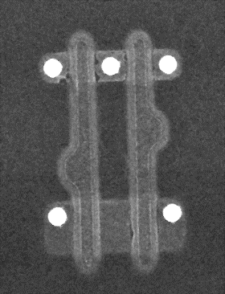
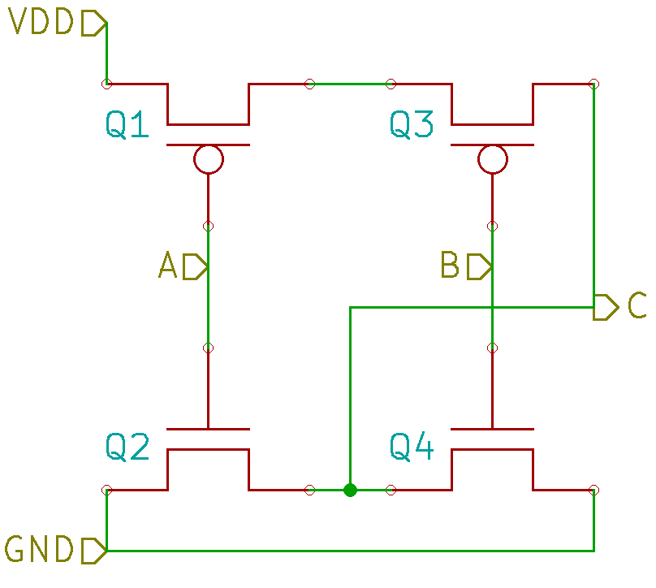

ASIC front end (wishlist only ☹)

Slide 9
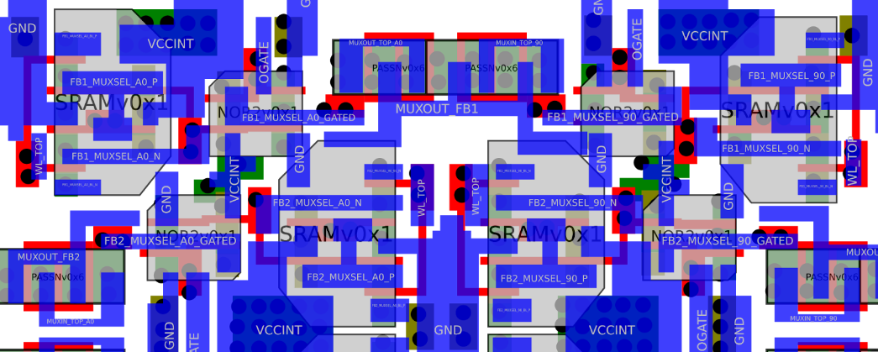
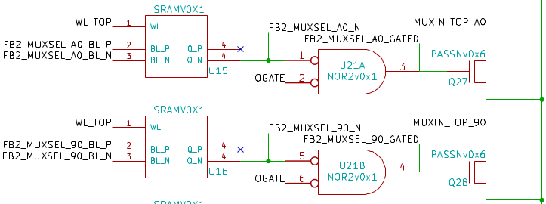
ASIC front end (by hand)

Slide 10
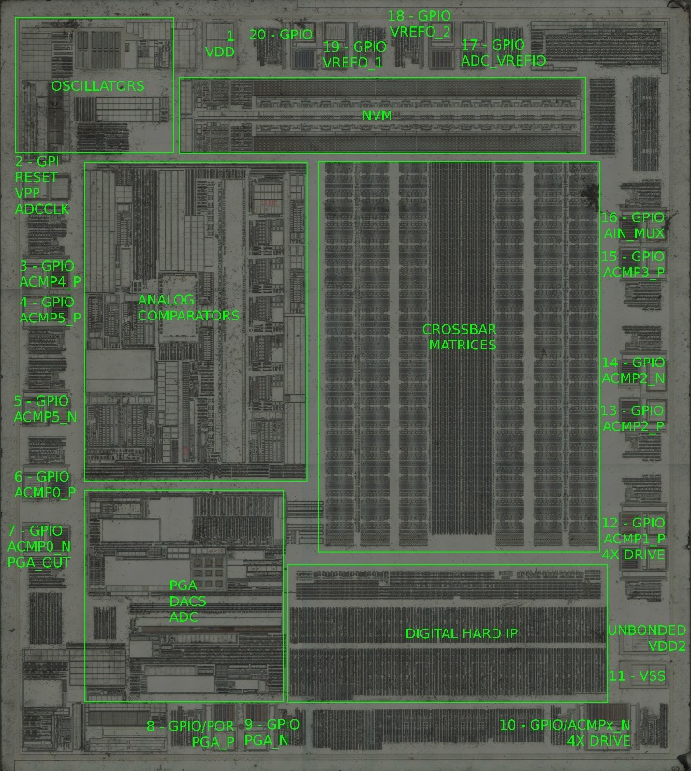
Silego GreenPAK4 (SLG46620)
Tiny mixed signal FPGA
FPGA fabric: 26 variable-sized LUTs, 12 FFs
Oscillators
Analog hard IP: Comparators (w/ vref), ADC, DAC
Digital hard IP: counters, sh.regs, compare/PWM

Slide 11
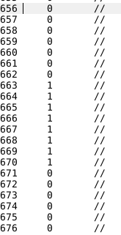
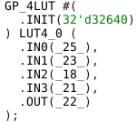
Silego GreenPAK4 front end (beta)

Slide 12
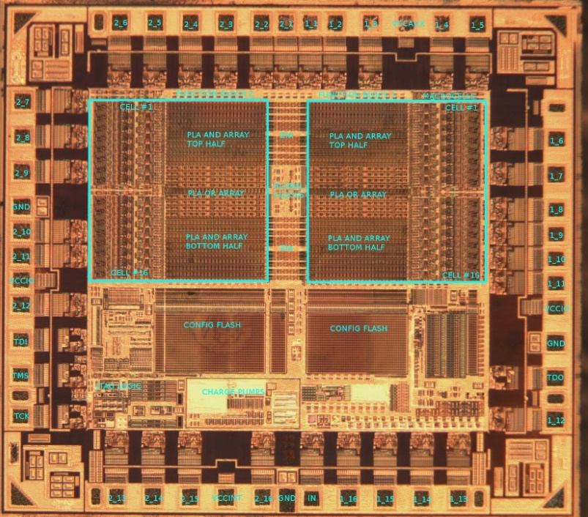
Xilinx CoolRunner-II (XC2C32A)
Straightforward PLA-based CPLD
2 function blocks, each with:
16 GPIOs
16 macrocells w/ XOR, FF
80x56 AND array
56x16 OR array
Global clock/reset trees
One extra input

Slide 13
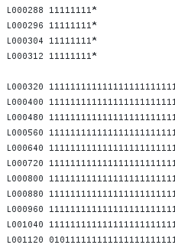
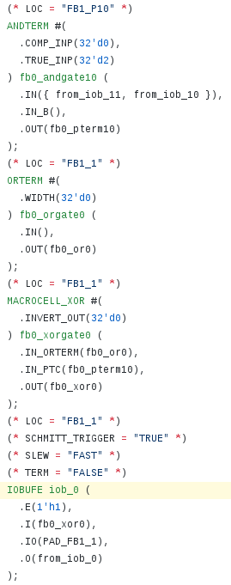
Xilinx CoolRunner-II front end (alpha)

Slide 14
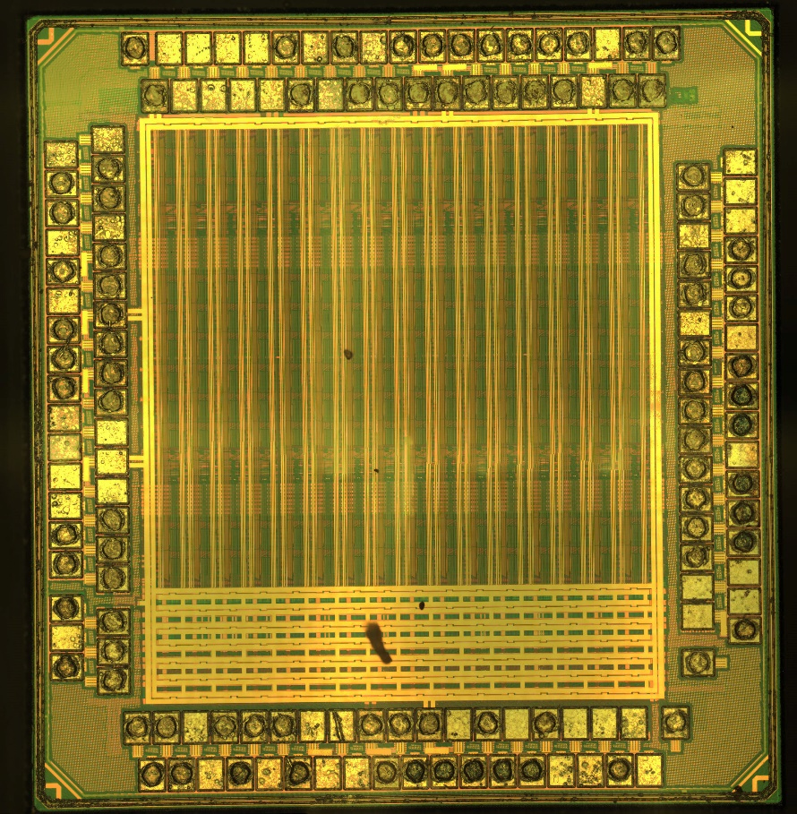
Lattice ice40 (ice40lp1k)
On die OTP
16x10 tiles of 8 LUT4s
4Kb block RAMs
PLLs
Supported by open IceStorm toolchain

Slide 15
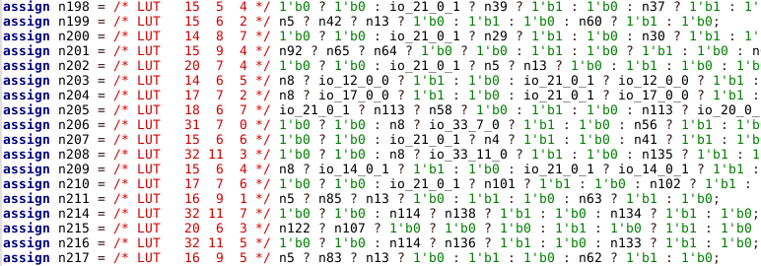
Lattice ice40 front end (alpha)
Use icebox_vlog.py to convert to low level Verilog
Read generated Verilog and untechmap
Not primary development focus for now
As we scale to larger devices, will get more testing

Slide 16
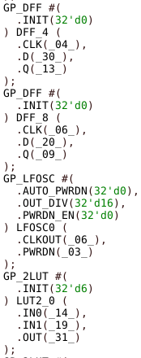
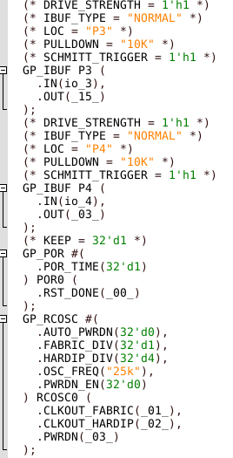
Native netlist
A sea of standard cells
No structure whatsoever
Unused FPGA cells removed

Slide 17
Native netlist

Slide 18
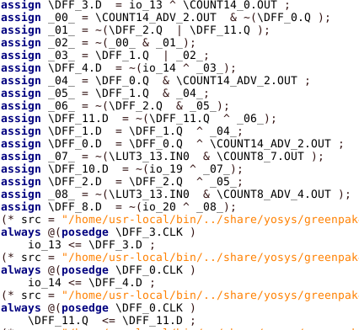
Intermediate Representation
Replace LUTs and library cells with generic equivalents
Generic Boolean logic
Preserve analog/mixed signal IP as instances

Slide 19
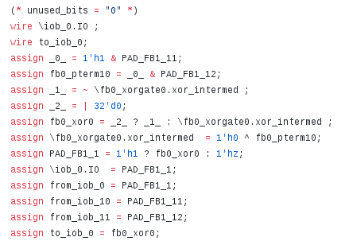
Intermediate Representation

Slide 20
De-synthesis
Find isomorphisms in IR netlist
Replace them with more abstract equivalents
Use existing coarse-grained synthesis algorithms!

Slide 21
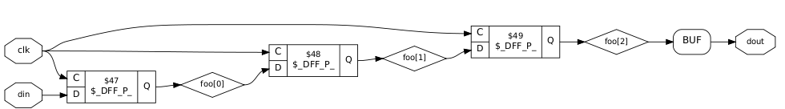
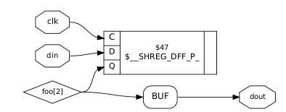
Shift registers
Already in Yosys for coarse-grained synthesis
But works on raw netlists too!
Find chains of DFF w/ same clk/reset*
* DFFCE needs more work

Slide 22
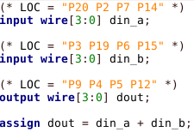
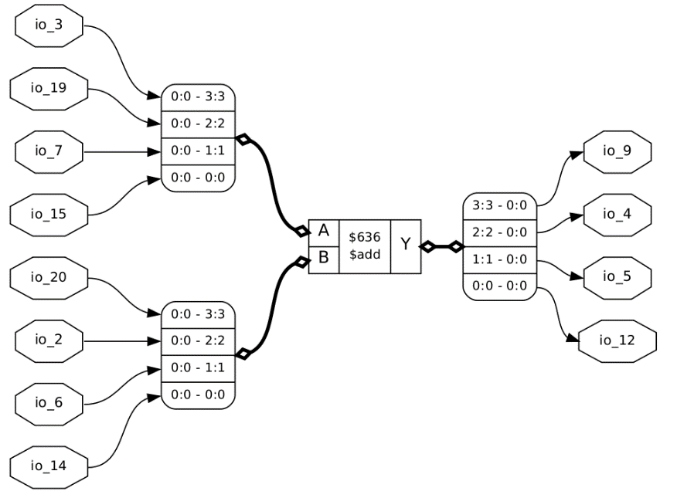
Adders
Find half/full adders and chain them
Caveat - Addition is commutative! (see pin 7)

Slide 23
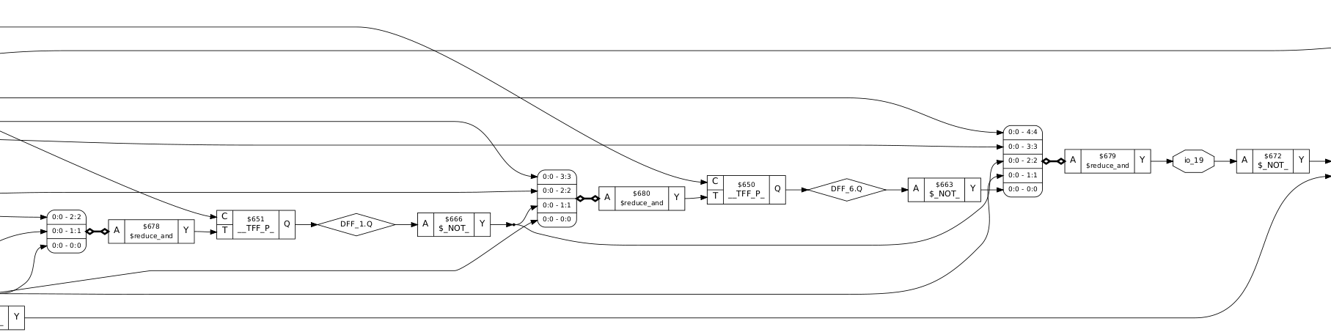
Multi-bit gates
Combine chains of 2-input gates into larger gates
Yosys considers these reductions of a single vector
Wide gates = comparators etc

Slide 24
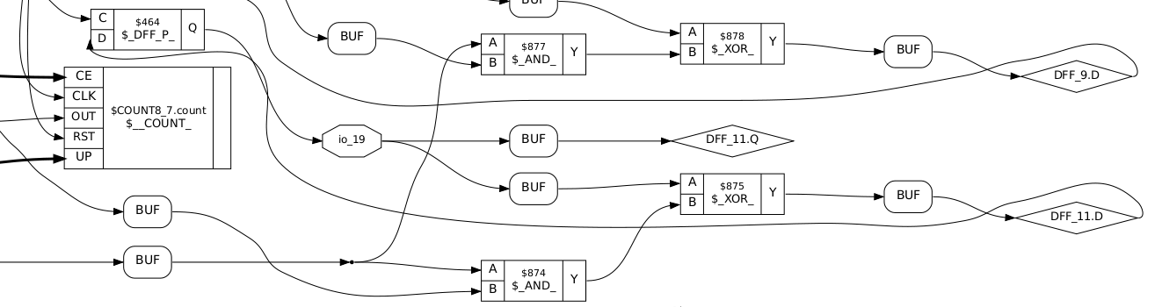
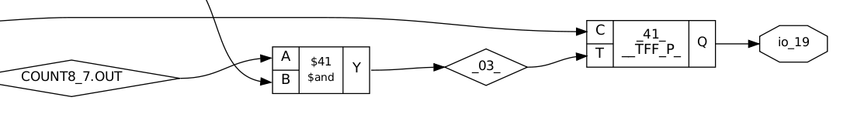
Toggle flipflops
DFF + XOR = TFF
Extracting these makes other structures easier to find

Slide 25
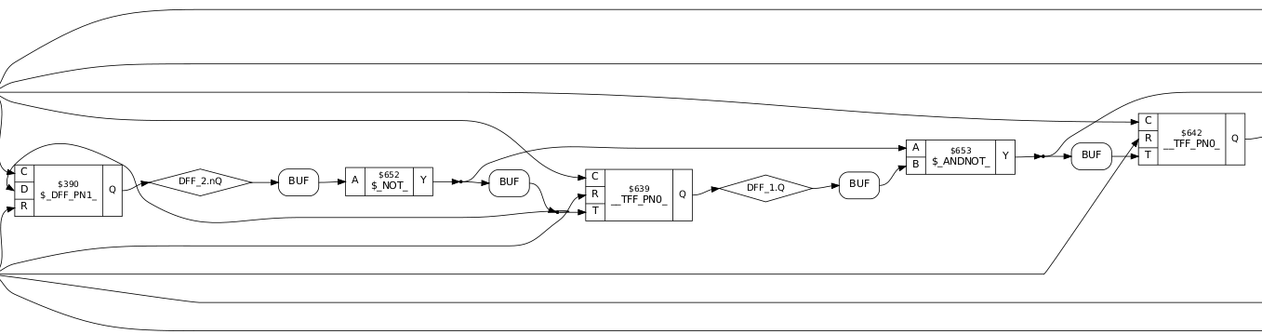
TFF-Based Counters
Chained TFFs = binary counter

Slide 26
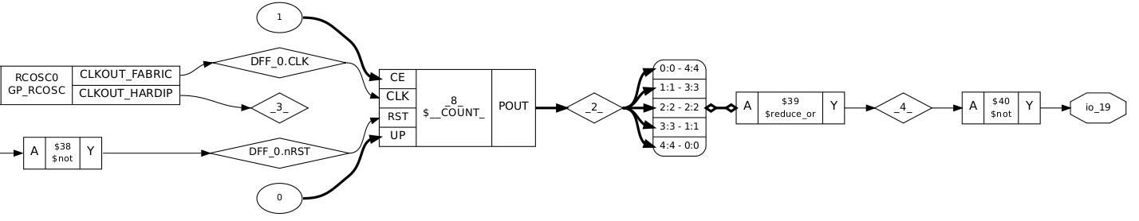
TFF-Based Counters
Current pass always produces POUT
Comparator not yet absorbed into OUT port

Slide 27
TFF-Based Counters
Non power-of-two needs more work

Slide 28
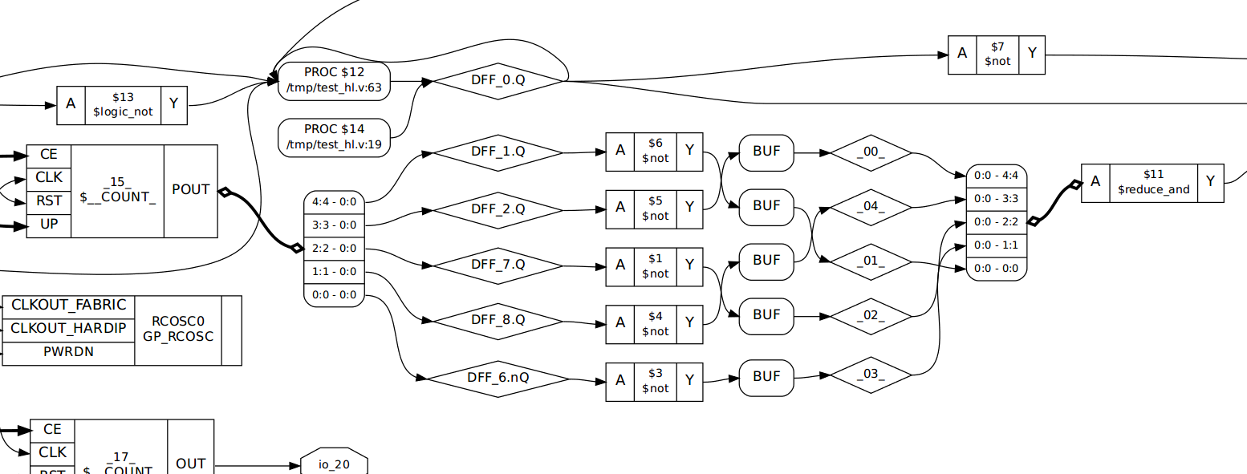
Bus detection
Some blocks have inherent ordering on outputs
Infer multi-bit buses from these
Heuristic: if one input to block is a bus, so is the other

Slide 29
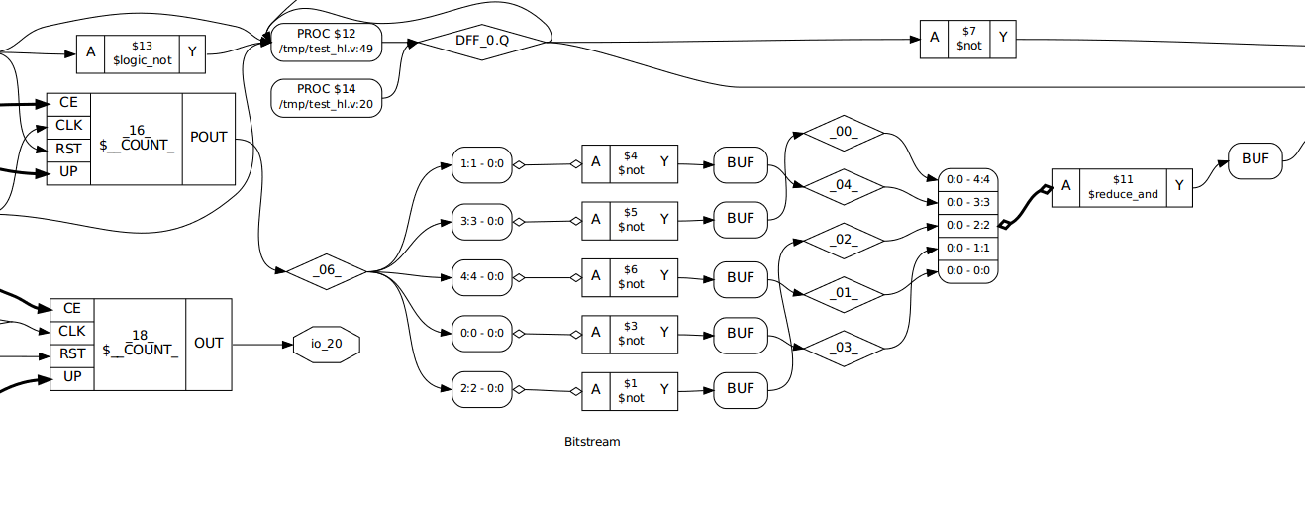
Bus detection

Slide 30
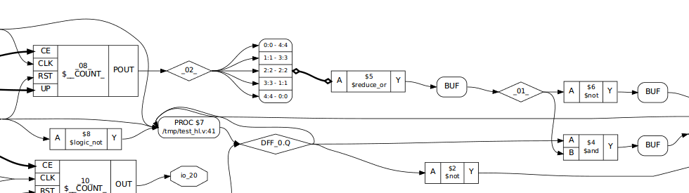
DeMorgan for reductions
If &() or |() has lots of inverted inputs, push the inverter
This optimization is useful for synthesis too!

Slide 31
How about some less trivial tests?
Feature extraction works decently on larger designs
We’re still working on visualizations
Current renderer (Yosys “show” -> xdot) scales poorly
Long run time to place graph elements
Non-interactive, can’t move nodes or rename them
Doesn’t show parameters or attributes well
Very poor handling of high fanout nets

Slide 32
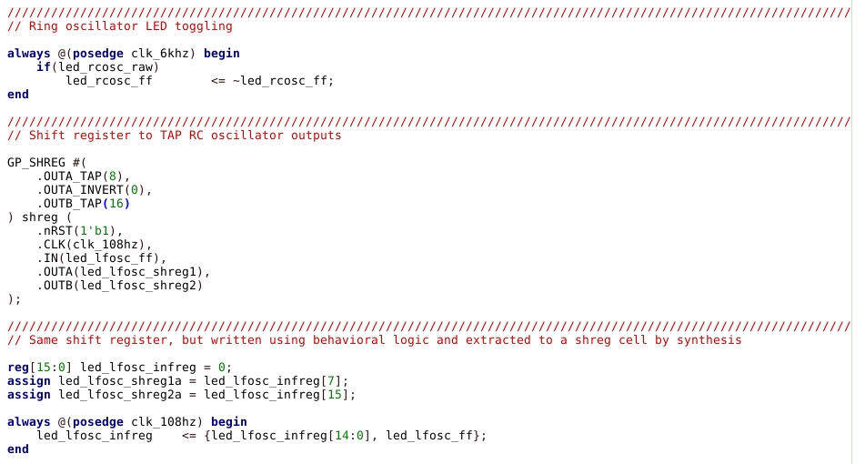
LED chaser (GP4)

Slide 33
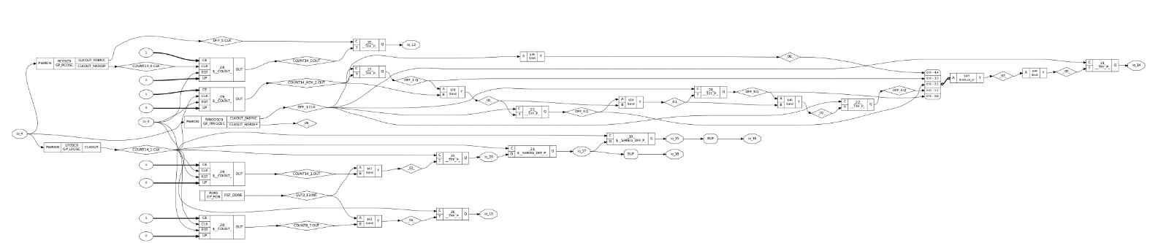
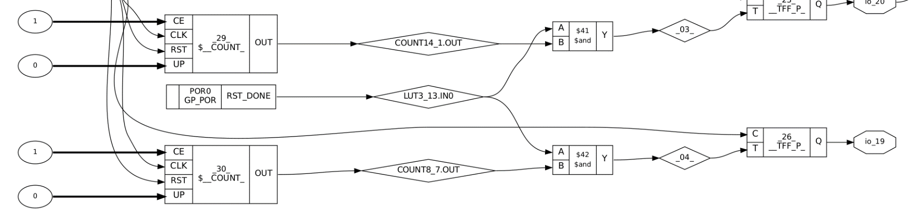
LED chaser (GP4)

Slide 34
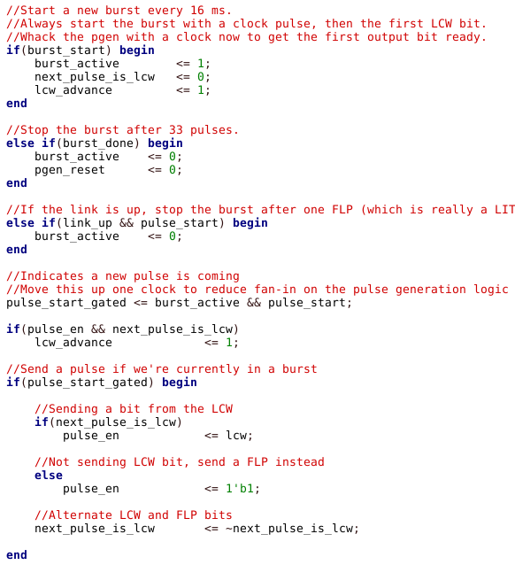
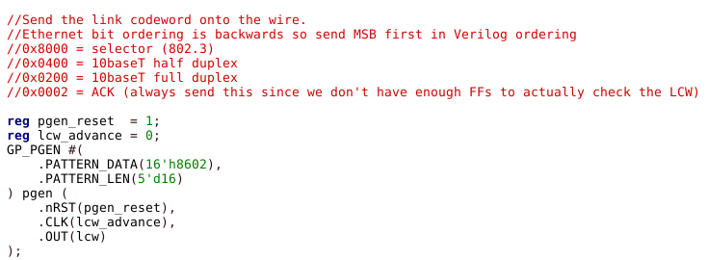
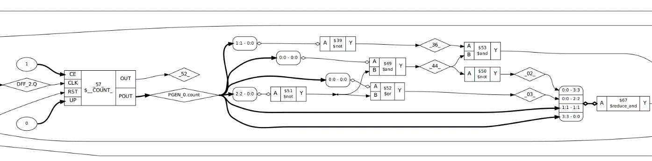
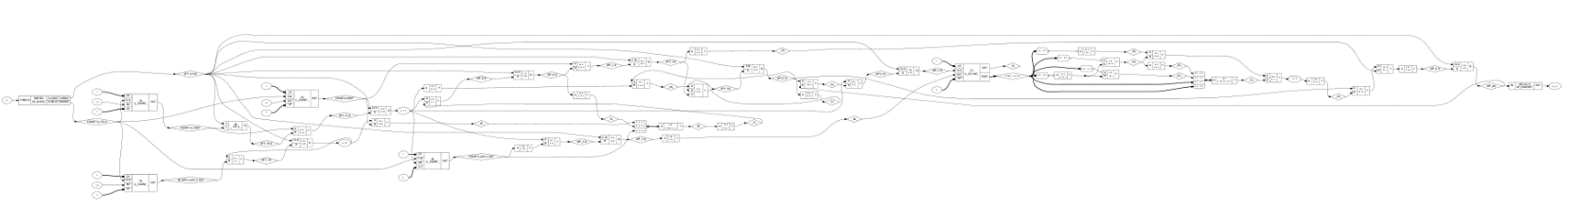
10baseT autonegotiation (GP4)

Slide 35
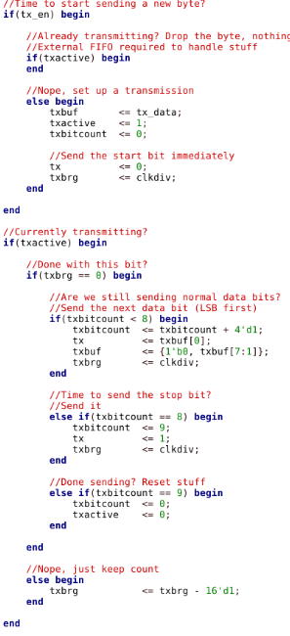
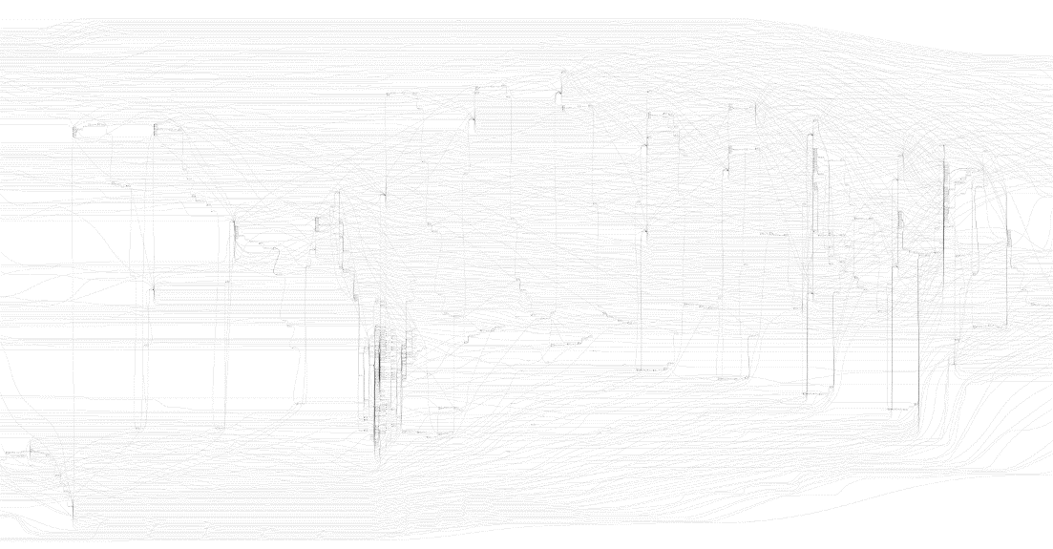
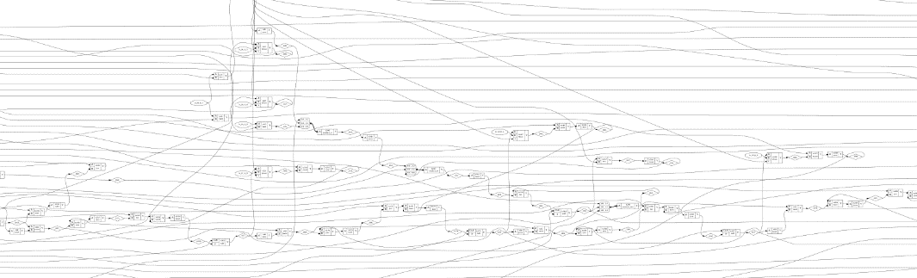
8N1 UART TX (ice40)

Slide 36
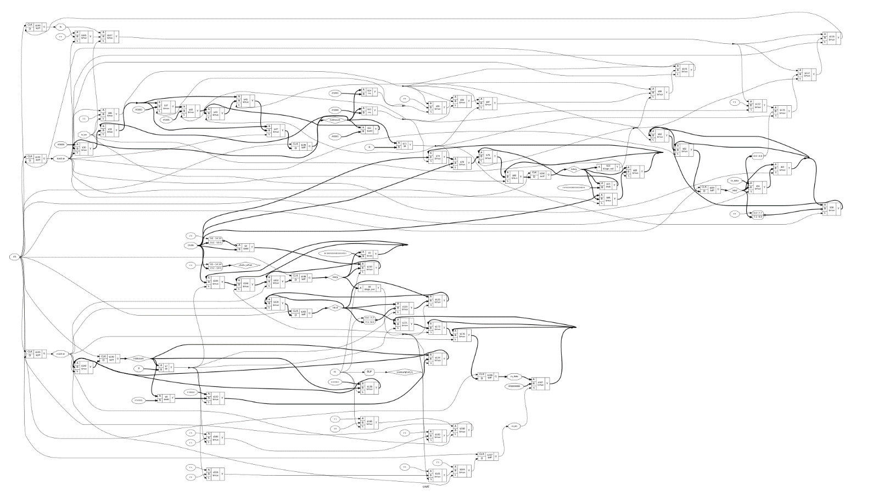
Original UART (TX+RX) pre-techmap
Clearly we have a ways to go!

Slide 37
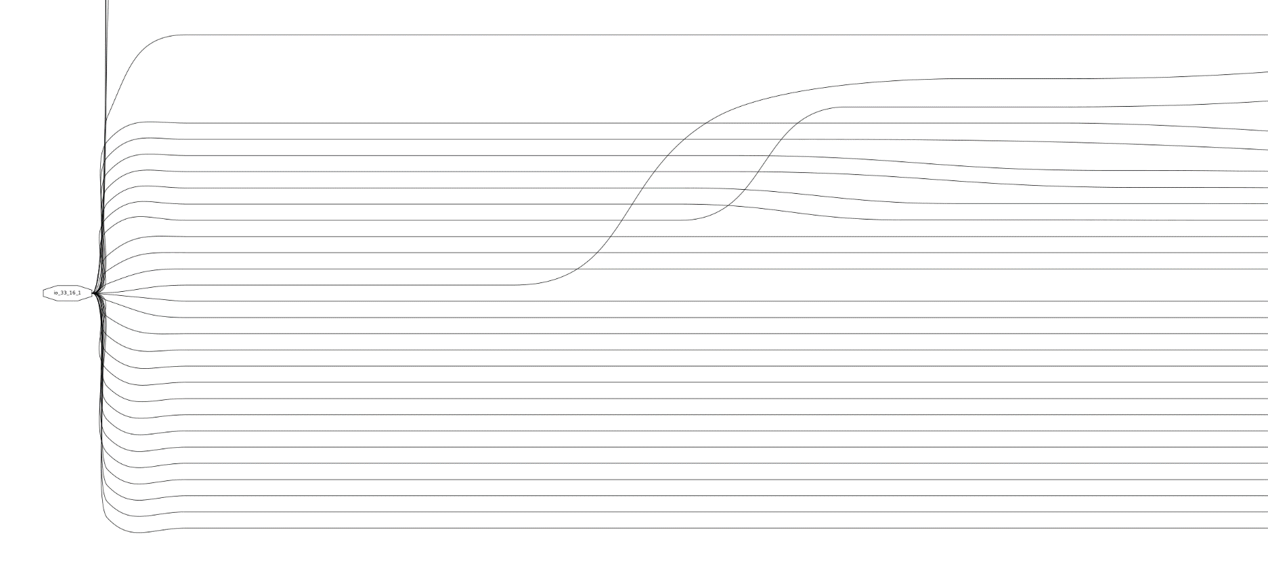
Graphviz doesn’t handle clocks well

Slide 38
Like Pulling Bitstreams
Firmware update files (if cleartext)
If encrypted, DPA usually works
“Improved Side-Channel Analysis Attacks on Xilinx Bitstream Encryption of 5, 6, and 7 Series”, COSADE ‘16
Hardware defeats of lock bits (if on chip)
Conjecture: Reading antifuses by FIB VC + CV?

Slide 39
Longer Term Roadmap
Add an interactive GUI
Support for extracting hierarchy and processes
Most likely human-guided w/ automated implementation
Draw approximate hierarchy and use min-cut?
Support for more FPGA/CPLD devices
Implement ASIC front end
More advanced analytics

Slide 40
Longer Term Roadmap
Traceability back to physical layout (for invasive)
Physical IP recognition for ASIC
Find known SRAM, efuse, PLLs, etc
Ideally: ML classifier for unknown physical IP?
“FLIRT” for IP cores
NP-complete in general case ☹
Can we use randomization, spatial partitioning, etc?
Won’t find everything, but is it good enough?

Slide 41
Get The Code
https://github.com/azonenberg/yosys/ My fork of Yosys with additional RE-focused passes ISC license
https://github.com/azonenberg/openfpga Bitstream support / PAR for CoolRunner + GreenPAK LGPL

Slide 42
Acknowledgements
John McMaster – wet lab for XC2C samples
Clifford Wolf – lots of new Yosys features

Slide 43
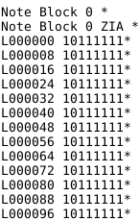
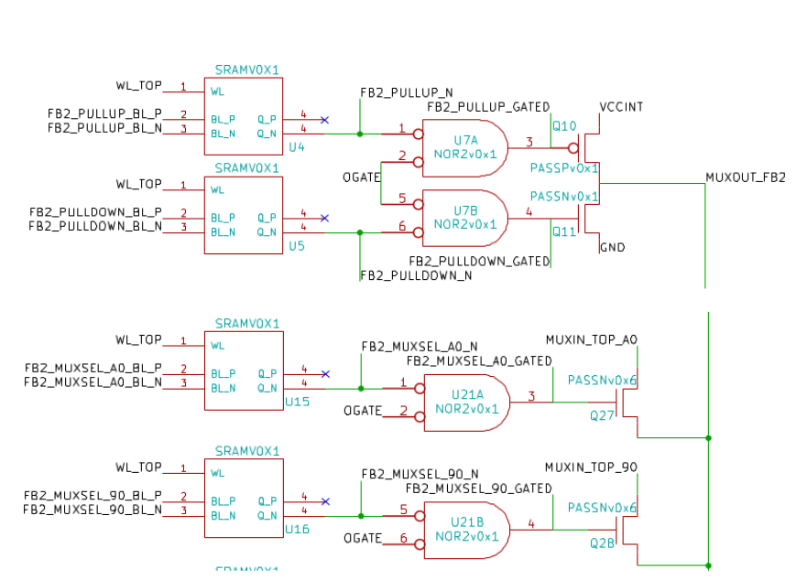
Fun with XC2C32A “suicide bitstream”

Slide 44
Questions?

